Slide 1
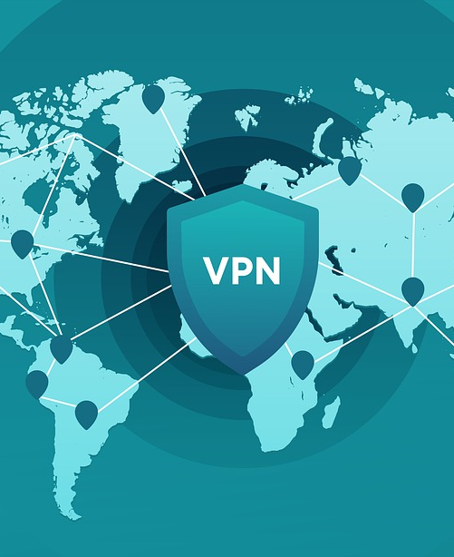
Virtual Private Network
By: Miten Patel

Slide 2
What is a Virtual Private Network?
Virtual Private Network is network that connect you as the user with sites you want to go through.
In today's technological community, Virtual Private Network(VPN) is considered one of the most used and protected networks.

Slide 3
The usage of VPN
VPN is mostly used by business, no matter If they are small company who want to expand their network or big corporate companies who want a secure network to communicate and do business with other companies.
There are also private users who just want VPN for their own privacy.
VPN is widely used in countries which restrict their internet, so the user can search the web without any restriction.

Slide 4
Technologies behind VPN
There are two type of VPN
First being, Remote- access VPN which allows users to have a secure connection with a remote computer network. This VPN uses two components, the Network Access Server and client software.
Network Access Server is a type of gate way that requires the user to enter appropriate credential to connect to the VPN network.

Slide 5
Technologies behind VPN
The second component is
Client software
Client Software has to be installed into computers in order to make a connection to VPN and to maintain that connection.
Most computers that are manufactured today already have built in client software, so the user doesn't have to go through the process to download software.

Slide 6
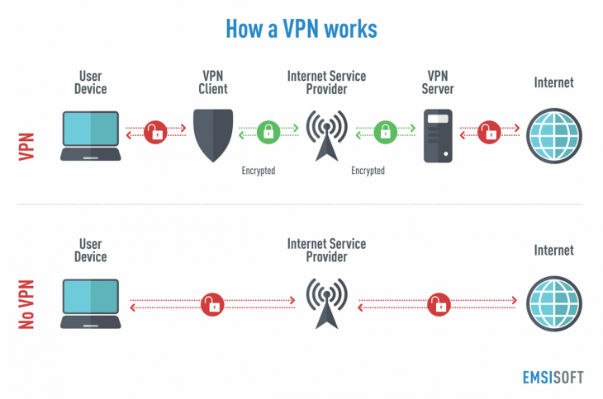

Slide 7
Pros and Cons About VPN
Pros
Allows access to censored content
Secured and protected
Affordable
Cons
Slow Connection Speed
Anti-VPN Software
Difficult to configure.

Slide 8
Thank You

Slide 9
References
https://www.essaysauce.com/information-technology-essays/virtual-private-network-vpn-security/
https://www.ukessays.com/essays/information-technology/history-of-the-virtual-private-network-information-technology-essay.php

